Slide 1
Project Deep Learning Explanation of brain tumor classification network
Korea University, Biomedical Engineering
BREIN Lab
손두환

Slide 2
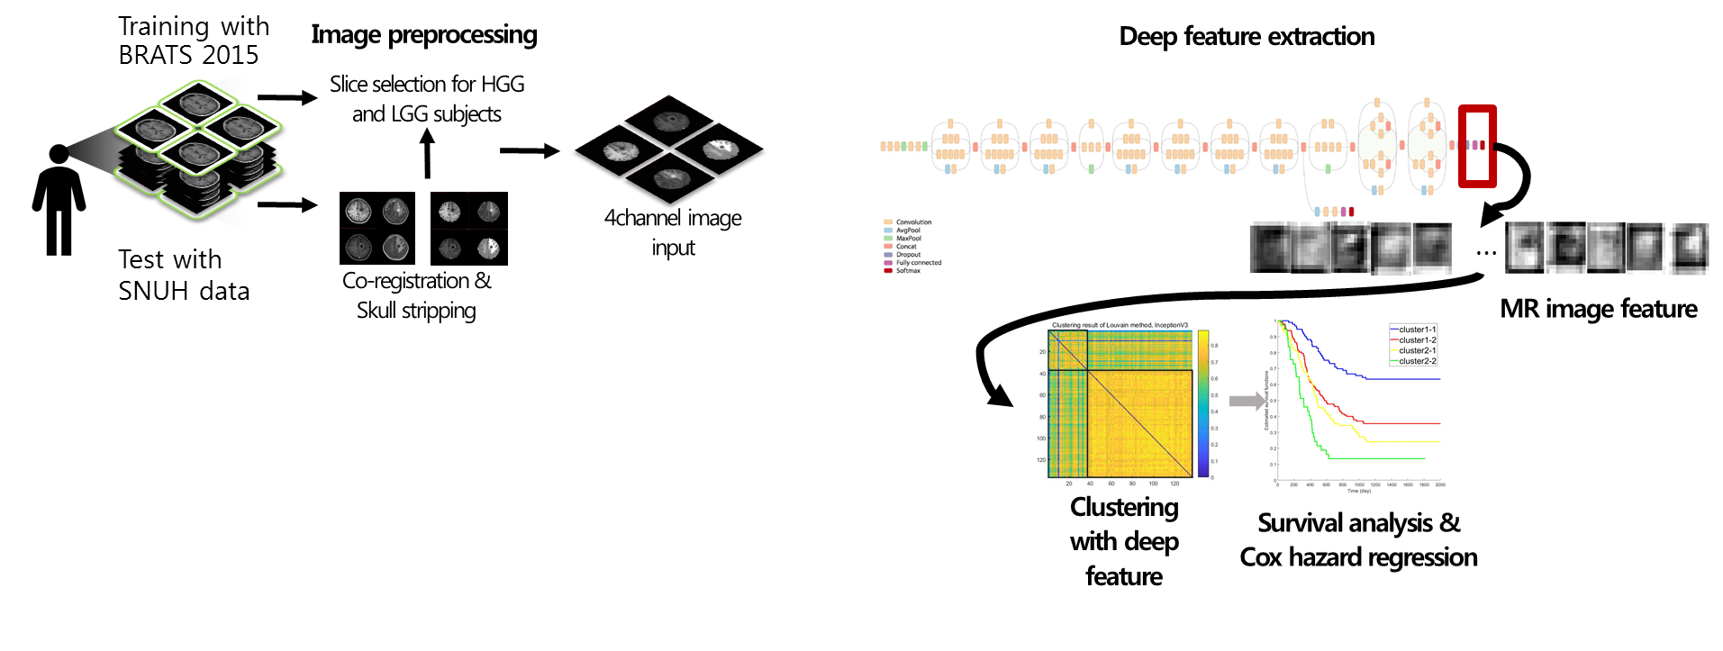
Glioma feature explanation
Overview
Brain glioma patient survival analysis with MR image feature (previous work)
Explanation of the MR image feature with class activation map with imaging features
Subject clustering: Louvain method
Survival plotting: Kaplan-Meier plot

Slide 3
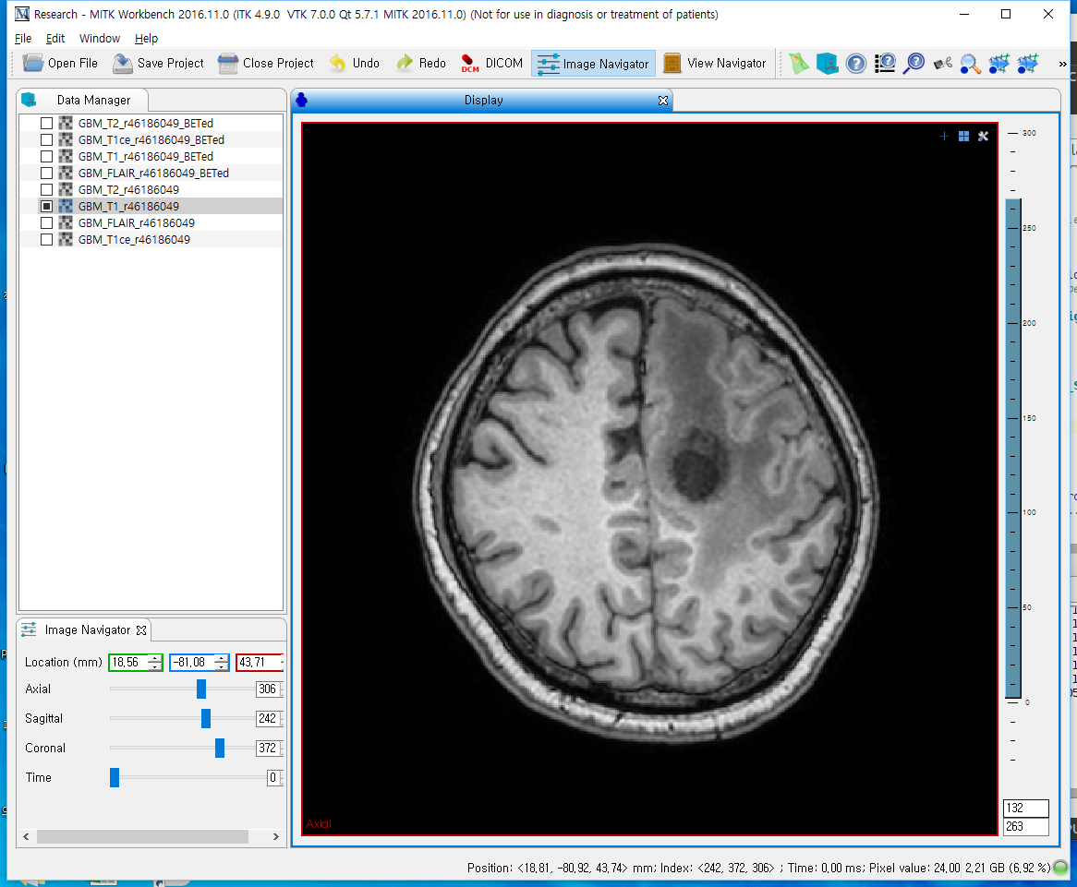
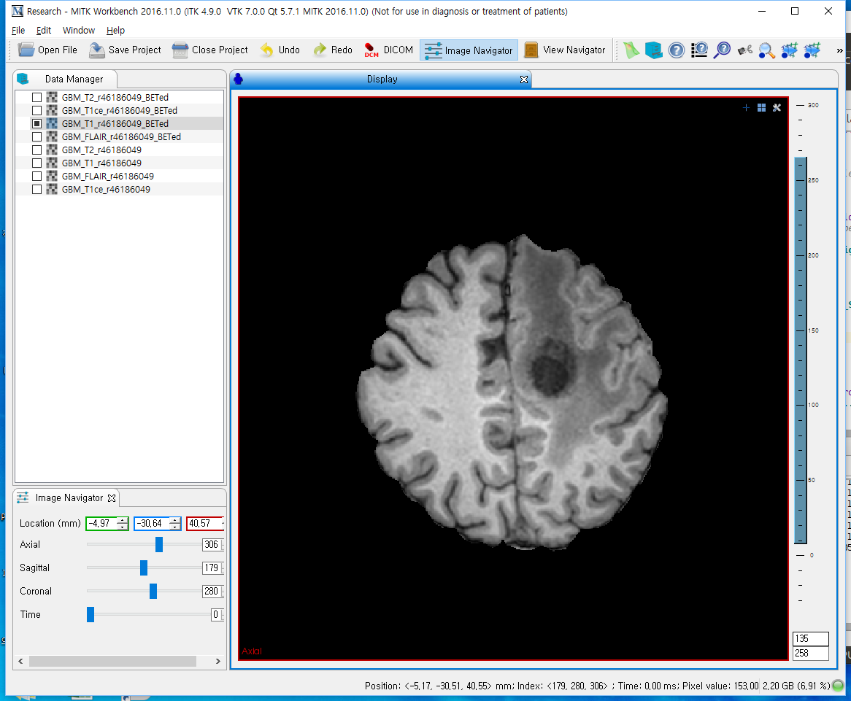

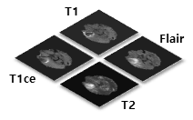
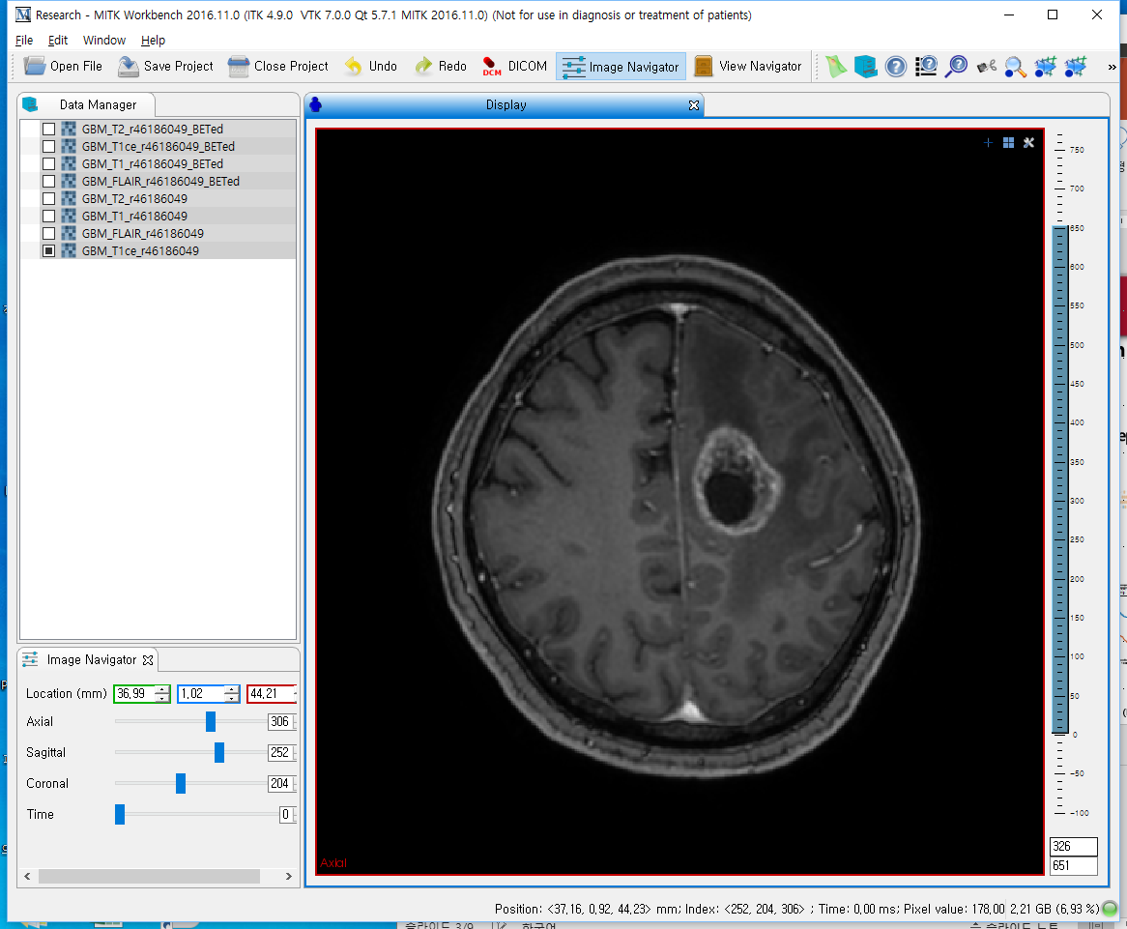
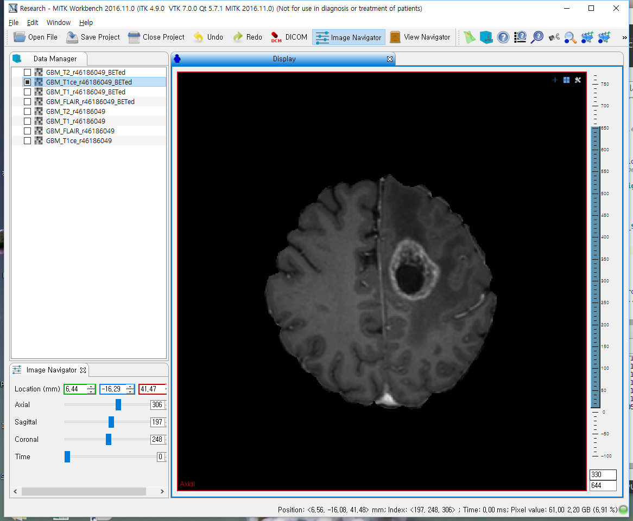

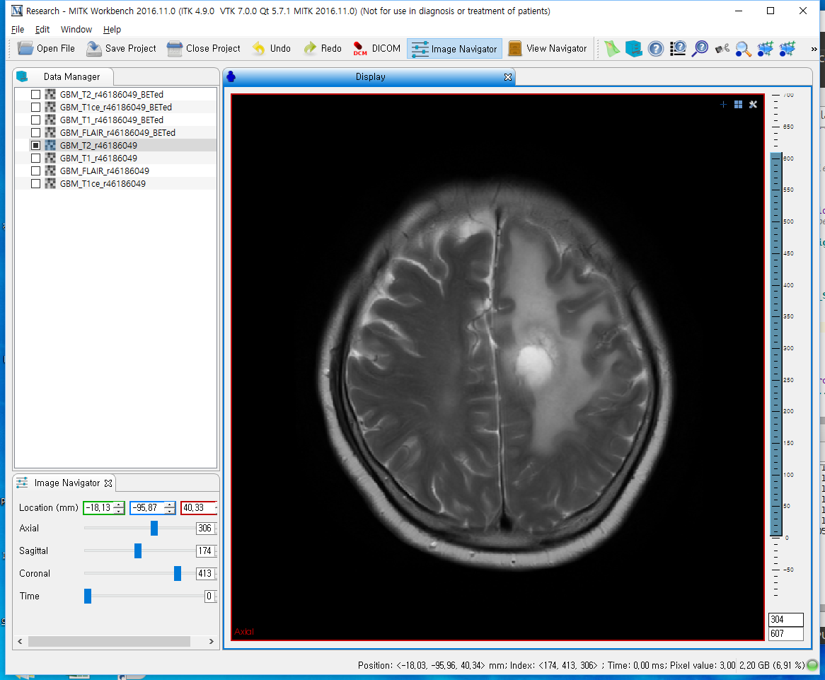
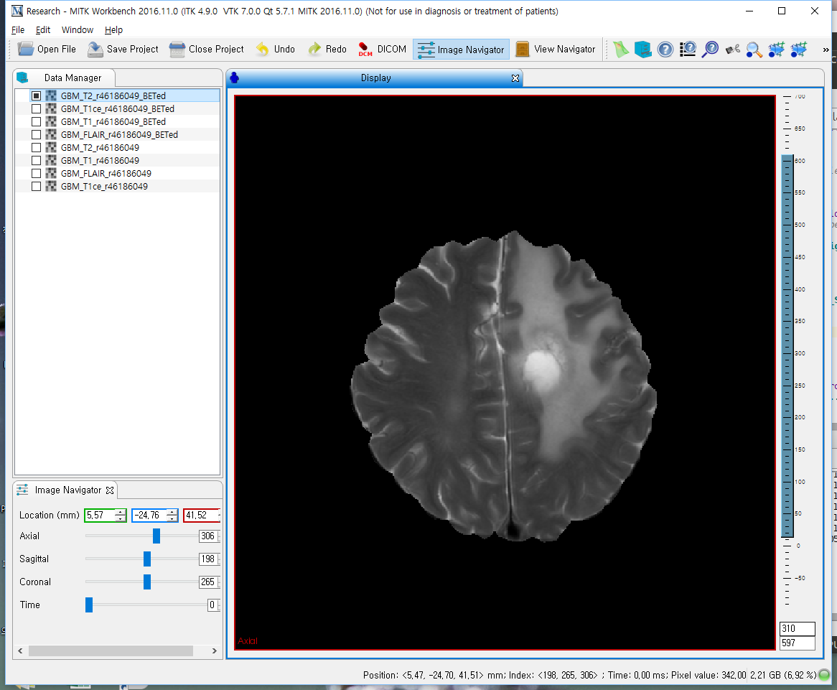
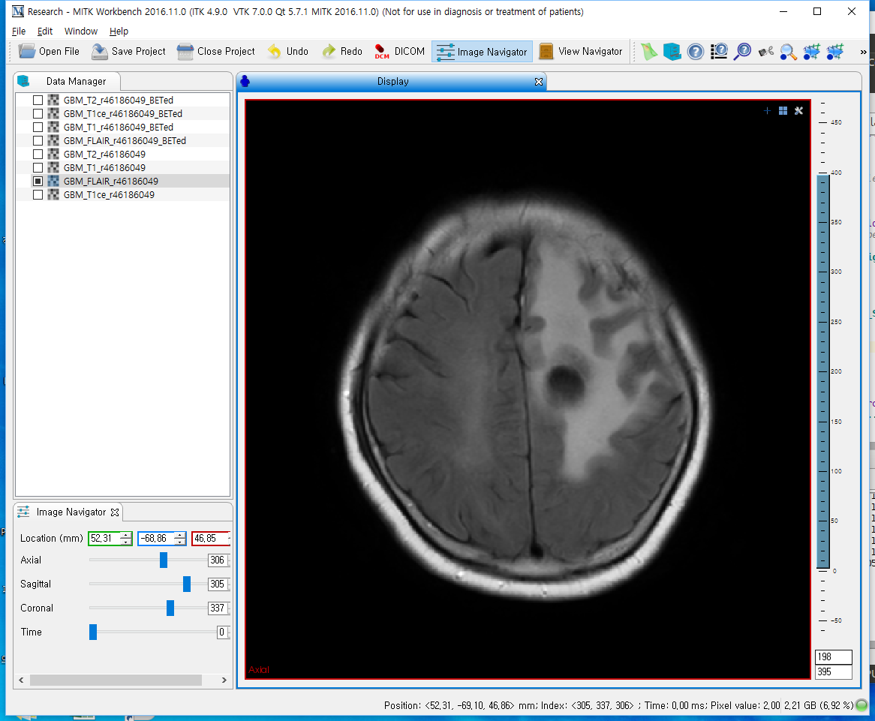
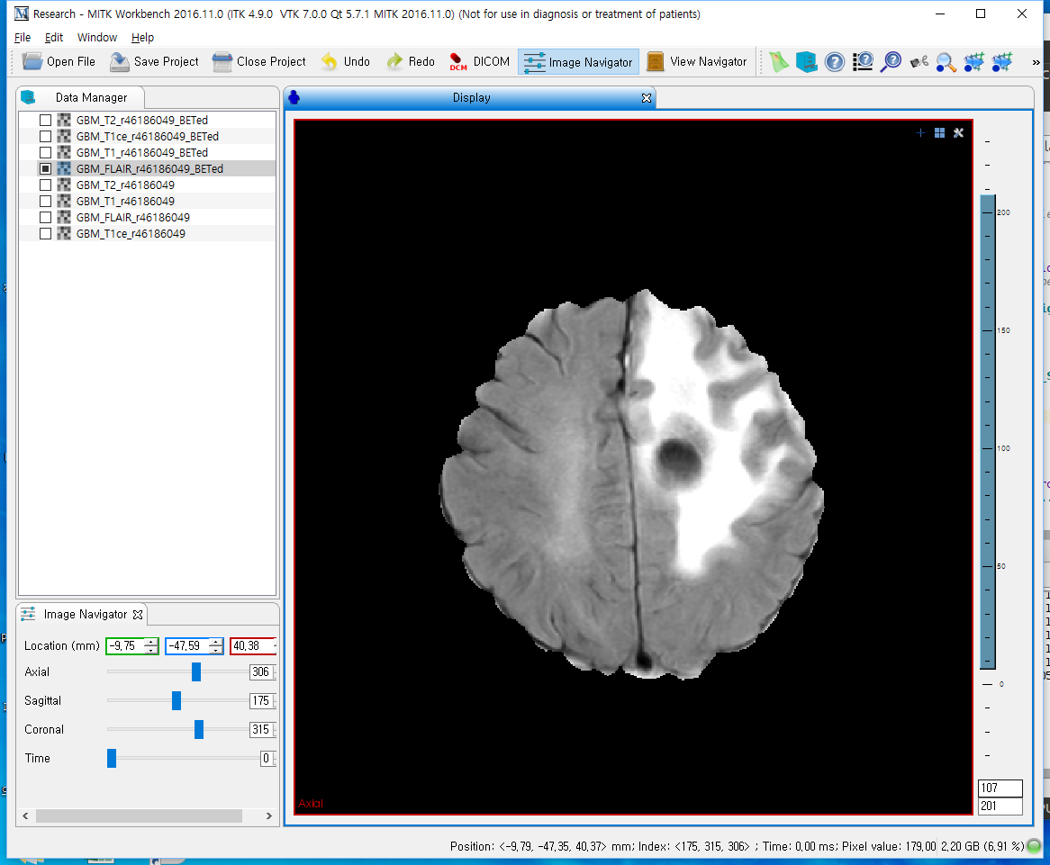
Glioma feature explanation
Preprocessing
Data pre-processing – SNUH data (T1, T1ce, T2, FLAIR)
FSL
Coregister T1ce, T2, FLAIR to T1
Manually find tumor location and extract tumor region
MRI(4ch)
From test data set, extract 4 channel image
Skull stripping of all modalities

Slide 4
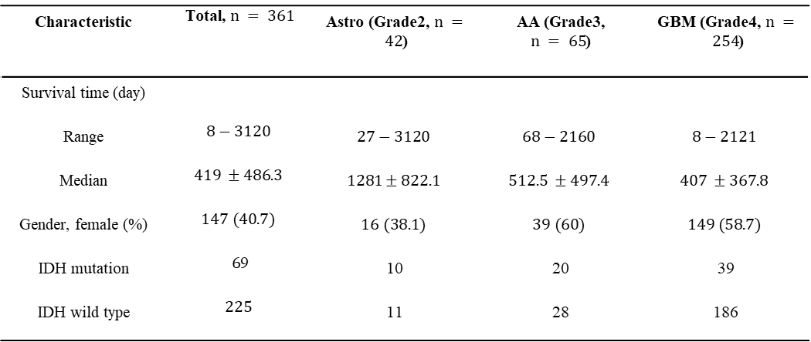
Glioma feature explanation
Data
BRATS 2015 for training
SNUH for Test and analysis
Survival time, gender, IDH mutation
BRATS 2015 data
처리된 SNUH data
BRATS 2015 | LGG | HGG
Subjects | 54 | 220
Slices | 2454 | 6005
Characteristic | Total, $n = 361$ | Astro (Grade2, $n = 42$) | AA (Grade3, $n = 65$) | GBM (Grade4, $n = 254$)
Survival time (day)
Range | $$8−3120$$ | $$27−3120$$ | $$68−2160$$ | $$8−2121$$
Median | $$419 ±486.3$$ | $$1281±822.1$$ | $$512.5 ±497.4$$ | $$407 ±367.8$$
Gender, female (%) | $$147 (40.7)$$ | $$16 (38.1)$$ | $$39 (60)$$ | $$149 (58.7)$$
IDH mutation | $6$9 | 10 | 20 | 39
IDH wild type | $$225$$ | 11 | 28 | 186

Slide 5
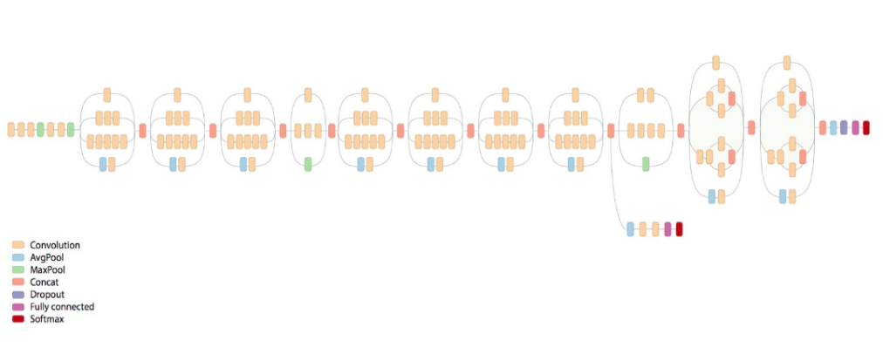
Glioma feature explanation
Model learning & Imaging feature extraction
Model learning: image classification LGG(grade2) vs HGG(grade3,4)
HGG 3등분, LGG 전체 사용(class imbalance)
InceptionV3 network, Training with BRATS2015 data
학습 후 SNUH test set으로 Imaging feature 추출: one feature vector for one image
한 개체에서 나온 feature vector element-wise averaged
Imaging feature

Slide 6
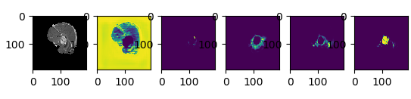
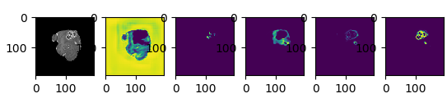
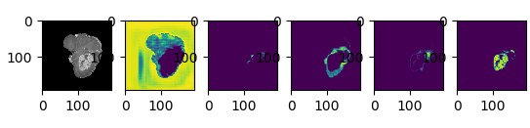
Unet SNUH dataset segmentation result
Unet segmentation 학습으로 tumor core 자동 추출 파이프라인 구축
4가지 tumor type을 아주 정밀하게 구분하지는 못하지만, (dice coef = 0.87) tumor core는 함
CAM image와 tumor core label의 겹침 정도를 dice coefficient로 계산함

Slide 7
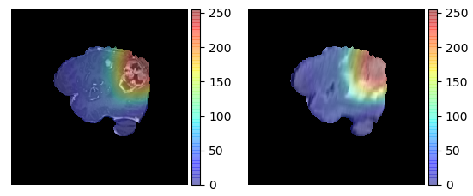
CAM image samples 1

Slide 8
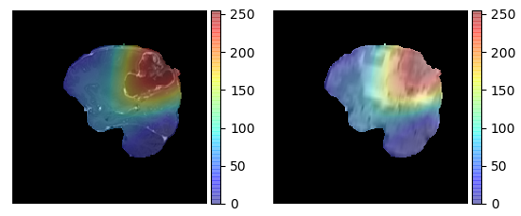
CAM image samples 2

Slide 9
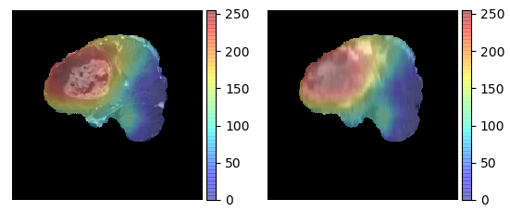
CAM image samples 3

Slide 10
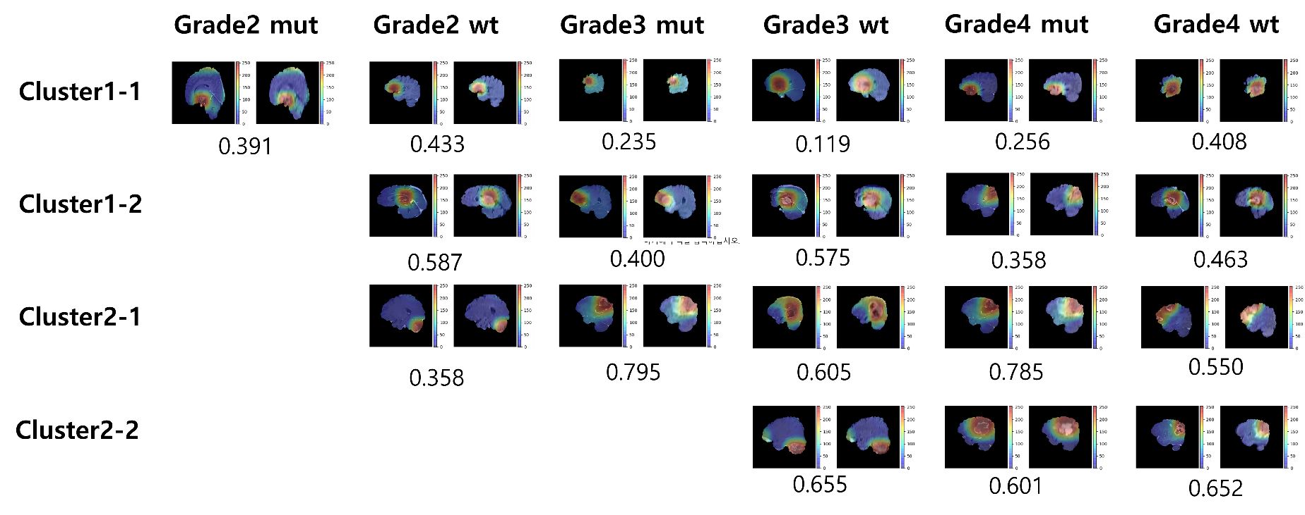
Glioma feature explanation
Feature visualization
Class Activation Map (CAM) image
HGG를 구분할때의 CAM image
Mut : IDH-mutation (예후좋음), wt : IDH-wild type (예후나쁨)
Grade가 낮을수록 예후가 좋은것으로 알려짐
Imaging cluster, Grade, IDH mutation 경우 별 대표 이미지

Slide 11
Glioma feature explanation
Interpretation
Class Activation Map (CAM) image
Cluster 내 에서 grade별 dice score는 grade가 커질수록 증가하는 추세는 보이지 않음
Grade별 dice score는 증가하는 추세를 보이는 것을 보아, 우리가 나눈 image feature 기반 cluster는 cluster index가 증가할수록 tumor core를 좀더 집중하는 것으로 볼 수 있음.
결국 image feature가 어떻게 작동하는지는 feature의 정보를 통해서 유의미한 clustering이 이루어 질 수 있었다는 것이며, deep learning network가 이런 특징들을 추출해서 잘 추상화 하였음을 의미함.
Imaging cluster, Grade, IDH mutation 경우 별 대표 이미지

